Slide 1


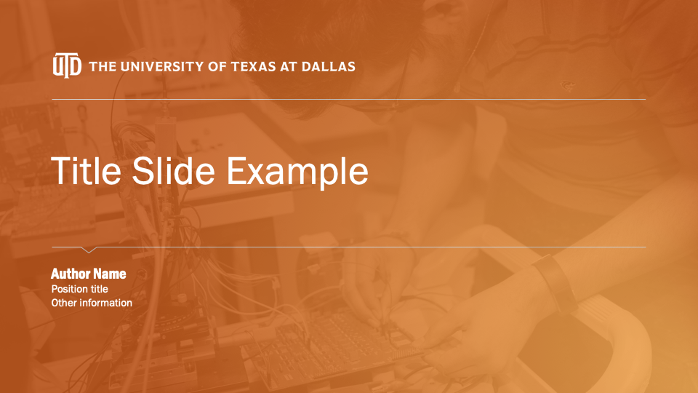
Text Summarization: Making Sense of the State of the Art
Leave the title slide with an orange background or add a photo.
Click the icon in the center and select a photo from your hard drive, one that complements the purpose of your presentation.
TIP: Use University-approved photos from utdallas.tandemvault.com
Send the photo to the back (select picture, go to Picture Format>Send Backward>Send to Back).
Use Picture Format>Crop to adjust what part of the image is shown within the frame.
With the photo selected, go to Picture Format>Format Pane to open the image options. The far right icon contains Picture Color and Picture Transparency options.
Set the Transparency slider to 85%-90% to make white text legible.
Recolor the image to grayscale, using an option in the Recolor Presets dropdown menu.
This results in a subtle orange-washed image behind your title text, like the example below.
Varun Joshi, Rick Gao, Fawaz Khurram, Adithya Viswanathan, Dylan Trang, Brian Nguyen

Slide 2
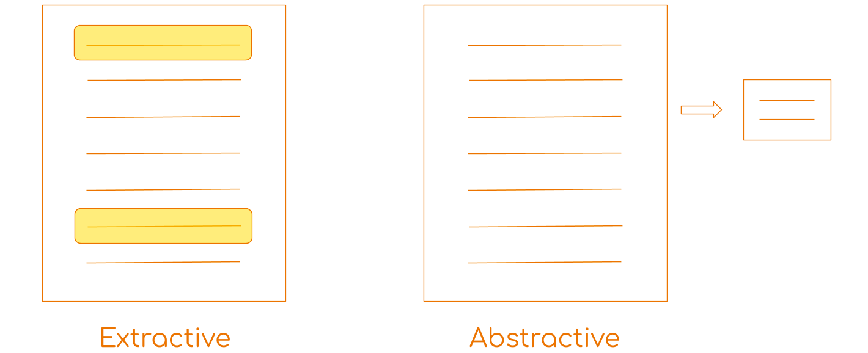
Defining Text Summarization
1
2
3
4
Original Text
Extractive/Abstractive Model
Generated Summary
Model Evaluation
Figure 1. Extractive vs Abstractive
Notes:
Adithya

Slide 3
Abstract
Lots of data and little analysis
Accuracy scoring needed
Abstractive & Extractive models tested
Effectiveness & limitations
5 Models
2 Datasets
Rouge Score
Notes:
Adithya
In order to better represent the problem, Fawaz will now define some important NLP terminology

Slide 4
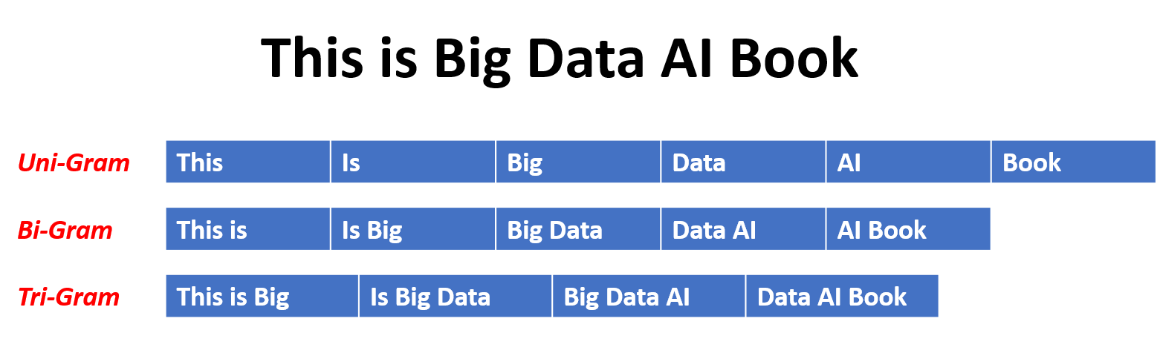
NLP Terminology: N-grams
Figure 2. N-Gram Example
[source: https://devopedia.org/n-gram-model]
Notes:
FAwaz
Common nlp terms like unigrams, bigrams, pos tagging,

Slide 5
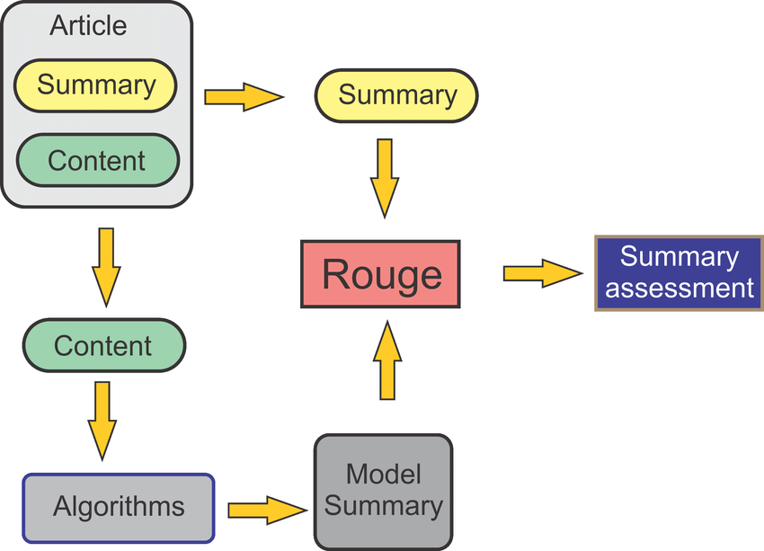
Evaluating Text Summarization
ROUGE - Recall Oriented Understudy for Gisting Evaluation
Figure 3. ROUGE Evaluation Process
[source: https://www.researchgate.net/figure/Specific-diagram-of-the-ASHuR-evaluation-process_fig2_326253494]
ROUGE-1 - compares number of unigrams between summaries
ROUGE-2 - compares number of bigrams between summaries
ROUGE-L - compares longest common subsequences
The scores range from 0-1 with 1 being a ‘perfect’ summary
Golden Summary
A golden summary is a human written summary that is set as the standard to compare the computer created summaries against.
Notes:
FAwaz

Slide 6
Datasets
State of the Union Speeches (1790 - 2019)
Pros: diverse style of language from multiple time periods, each speech is long
Cons: limited summarization corpora
Notes:
Ricck - define what state of union speeches are

Slide 7
Datasets
State of the Union Speeches (1790 - 2019)
Pros: diverse style of language from multiple time periods, each speech is long
Cons: limited summarization corpora
Reddit TIFU (2013 - 2018)
Pros: larger dataset (80,000 records), human summary for each post, non-standardized text
Cons: prone to spelling and grammatical errors
Notes:
Ricck - define what reddit tifu posts are (users post stories of a time something bad or unexpected happened to them). Characteristic of TIFU is human generated summary in each post

Slide 8
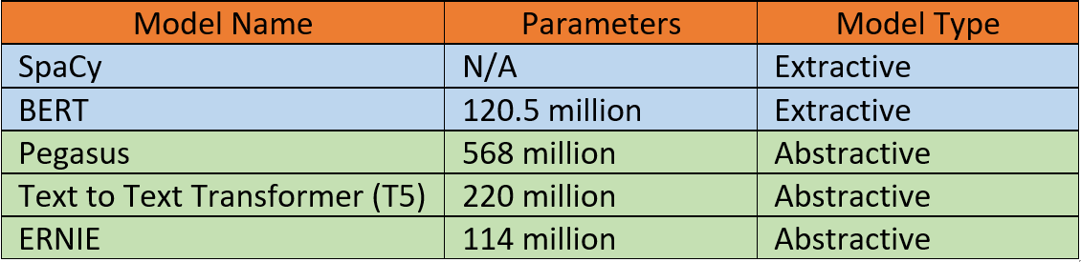
Table of Models
Figure 4. Text Summarization Models
Notes:
Pretty short slide
All of the models except for Spacy are transformer-based
Rick

Slide 9
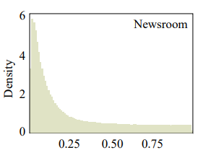
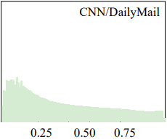
Experimental Results: Bigram Distribution
Figure 5. Relative location of bigrams within news datasets [7]
Notes:
rick

Slide 10
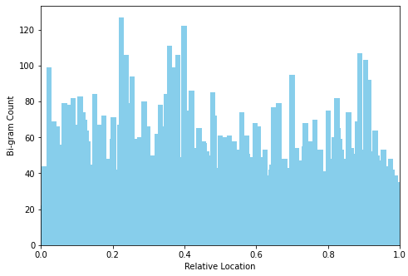
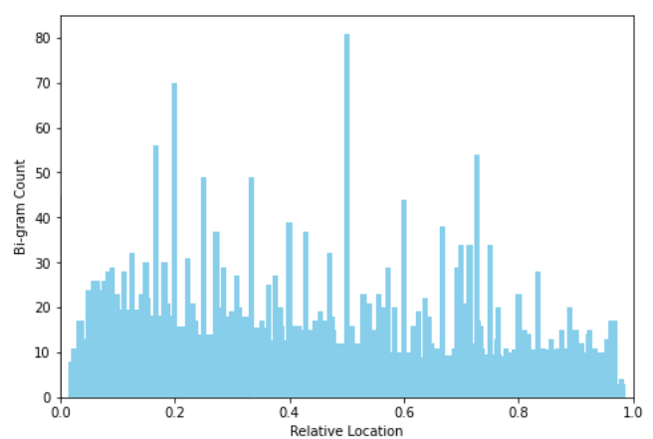
Experimental Results: Bigram Distribution
State of the Union Speeches
Reddit TIFU
Figure 6. Relative location of bigrams within source text
Notes:
Rick - uniform

Slide 11
Experimental Results
Relevance Example
BERT
today i was going to have a bath after a long day of painting kids faces at a carnival. all would go well, except being the genius i am, i put in some epsom salts (i always do for my bath), and i grabbed my bottle of peppermint essential oil. it's good for your skin!
today i was going to have a bath after a long day of painting kids faces at a carnival. all would go well, except being the genius i am, i put in some epsom salts (i always do for my bath), and i grabbed my bottle of peppermint essential oil.lately, i've been on a diy-pinterest-tumblr-let's-make-my-own-shit-and-be-fancy spree. the other day i took a 'detox bath' (fyi did nothing for me guys. uselessss). so, my brain totally went 'hey, trajectorys, put some peppermint in! it's good for your skin!' okay brain! so, instead of logically putting in like... 5 drops so it's nice and minty fresh smelling and just enough to work, i literally shook the thing full force all over the top of the bath water. i'm talking like... probably 50-100 drops. so i finish running the water, turn it off, and hop in. first five minutes went really well.. and then the cold started. okay, this is fine, it just is the peppermint cooling my skin. brain is like, just wait it out. so i stayed in.ten minutes in and i'm moving back and forth trying to keep the warm water warm, if i stopped moving it was like sitting in the water at the foot of a glacier.so i sit up. you know that feeling when you brush your teeth and drink ice water? that immense cold in your mouth? my back felt like that immediately. so now i'm sitting here and my back, my butt, and my ladybits are burning cold. like, sitting in the snow naked kind of cold. it's really uncomfortable... so indeed, tifu.
Notes:
Some models tend to only take info from the beginning due to training bias

Slide 12
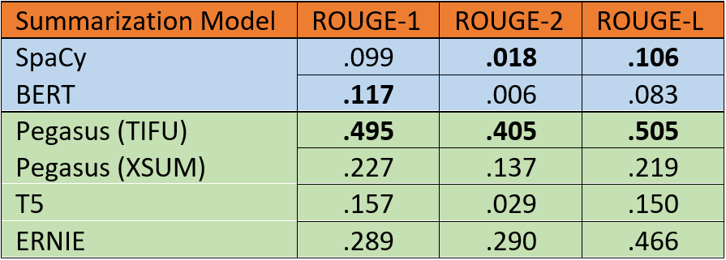
Experimental Results: ROUGE
Reddit TIFU
Figure 7. ROUGE Scores for summarization models
Notes:
Rick - talk about abstractive vs extractive performance

Slide 13
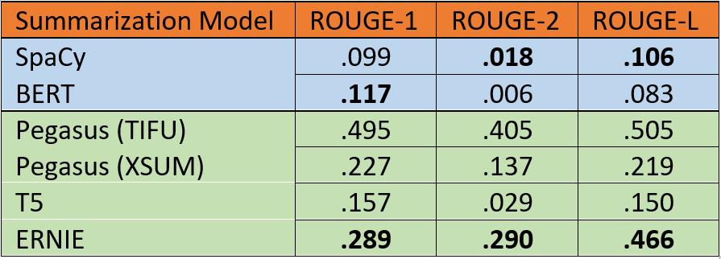
Experimental Results: ROUGE
Reddit TIFU
Figure 7. ROUGE Scores for summarization models
Notes:
Rick - talk about abstractive vs extractive performance

Slide 14
Experimental Results
Speech Summaries
G.W.Bush 2003 SotU Speech
Mr. Speaker, Vice President Cheney, Members of Congress, distinguished citizens
and fellow citizens: Every year, by law and by custom, we meet here to consider
the state of the Union. This year, we gather in this Chamber deeply aware of
decisive days that lie ahead. You and I serve our country in a time of great consequence. During this session of Congress, we have the duty to reform domestic programs vital to our country.
We have the opportunity to save millions of lives abroad from a terrible
disease. We will work for a prosperity that is broadly shared, and we will
answer every danger and every enemy that threatens the American people...
Generated Summary (T5)
john avlon: we have the opportunity to save millions of lives abroad from a terrible disease. he says we will not deny, we will not ignore, we will confront our problems with focus. america is blessed with recovery programs that do amazing work, he says.
Notes:
Dylan - this is an example of one of the speeches generated by one of our models, thr t5, on gwb 2003 sotu speech. We have determined that the t5 generated a summary that sums up the speech well, however it attributes the author to John Avalon, a modern political commentator, due to their similarity of language that it found on the cnn dataset. Models trained on the cnn/dailymail dataset tended to analyze gramatical structures and similarities in ngrams of certain speakers to try to connect a text to an author in order to generate a better summary, often a modern political speaker as opposed to an older figure.
Speech issues:
Since we couldn’t get golden summaries for the speeches, we couldn’t do any analysis on the speeches, so most of our research was focused on Tifu.
In addition, speeches are so large models aren’t able to summarize them
Untrained T5 generated summaries that were attributed to modern people due to training on datasets like cnn that have modern people using similar professional grammer

Slide 15
Experimental Results:
Original Text
today i was going to have a bath after a long day of painting kids faces at a carnival. all would go well, except being the genius i am, i put in some epsom salts (i always do for my bath), and i grabbed my bottle of peppermint essential oil.lately, i've been on a diy-pinterest-tumblr-let's-make-my-own-shit-and-be-fancy spree. the other day i took a 'detox bath' (fyi did nothing for me guys. uselessss). so, my brain totally went 'hey, trajectorys, put some peppermint in! it's good for your skin!' okay brain! so, instead of logically putting in like... 5 drops so it's nice and minty fresh smelling and just enough to work, i literally shook the thing full force all over the top of the bath water. i'm talking like... probably 50-100 drops. so i finish running the water, turn it off, and hop in. first five minutes went really well.. and then the cold started. okay, this is fine, it just is the peppermint cooling my skin. brain is like, just wait it out. so i stayed in.ten minutes in and i'm moving back and forth trying to keep the warm water warm, if i stopped moving it was like sitting in the water at the foot of a glacier.so i sit up. you know that feeling when you brush your teeth and drink ice water? that immense cold in your mouth? my back felt like that immediately. so now i'm sitting here and my back, my butt, and my ladybits are burning cold. like, sitting in the snow naked kind of cold. it's really uncomfortable... so indeed, tifu.
Original TL:DR
“peppermint + bath = burning cold ladybits”.
Notes:
Dylan
Here is what a piece of data from reddit could look like with the original human tldr that we use as the golden summary for the rouge comparison.

Slide 16
Experimental Results:
Example Summaries
BERT
today i was going to have a bath after a long day of painting kids faces at a carnival. all would go well, except being the genius i am, i put in some epsom salts (i always do for my bath), and i grabbed my bottle of peppermint essential oil. it's good for your skin!
PEGASUS (XSUM)
I'm not a huge fan of baths.
PEGASUS (TIFU)
put peppermint essential oil in my bath, it made me sit in the water at the foot of a glacier, and now my ladybits are burning cold.
Original TL:DR
“peppermint + bath = burning cold ladybits”.
ERNIE
today I was having a bath and put peppermint essential diy-pinterest-tumblr-let's-make-my-own-shit-and-be-fancy spree and I tried to keep warm, now my back is cold.
SpaCy
Today I was going to have a bath after a long day of painting kids faces at a carnival.
T5
lately, tifu has been on a diy-pinterest-tumblr-let's-make-my-own-shit-and-be-fancy spree. she's been on a 'detox bath' where she put in epsom salts and peppermint essential oil.
Notes:
Dylan
Here are the summaries generated by our models for this tifu.
The most notable one here is Pegasus tifu, who had the highest rouge score for this tifu. This is due to the fact that pegasus was pretrained on tifu, so it knows what rouge looks for in a comparison of tldrs.
T5- Good summary but wrong attribution
Peg Tifu- perfect summary (notable) talk about this one
Peg xsum- extremely short
Spacy- very extractive; takes beginning of data
Bert- highly extractive, took sentences from beginning of data
Ernie-

Slide 17
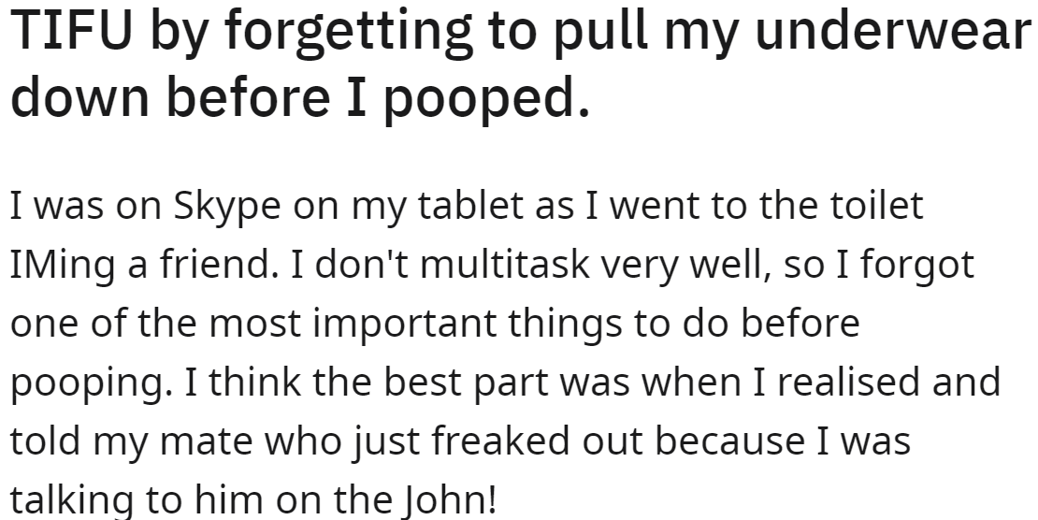
Analysis
Relevance
Writing Style
-Information Location
-Training Dataset Bias
-Outdated/
unprofessional speech
Figure 8. Example of Salient Information in Title
-Variable Writing style
Notes:
Relevance:
News articles tend to place the most relevant information at the beginning or end of the text
Models trained on CNN/DailyMail performed poorly on speeches and reddit datasets, where significant information is more scattered throughout the text
Important information for summarization was often located in the title, leaving it out of the main text.
Writing Style:
Models trained on modern English corpora struggled with summarization on older English texts such as speeches from 1790 to the 1850’s. Unable to recognize slang and outdated grammar
With the Reddit dataset, different writing styles resulted in variable summarization results generated from the model.
Abstractive models generally performed better on summarizing Reddit posts because the reference summaries are also generally abstractive. Human summaries are inherently abstract, which leads to better results when comparing to abstractive models

Slide 18
Limitations
Computation/Hardware
Golden Summaries
Language
-Model Size
-Input Size
-Availability
-How to get?
-English
-Style
Notes:
Computation Hardware: Many of the models that we ran were the smaller sized models due to our constraints with computation power. Results could be improved if we had resources to use larger model sizes. `
Large bodies of text such as speeches were not possible to use for some models due to maximum input size. ` `
Human Annotated: Golden summaries were not available with our speech dataset, which are necessary for ROUGE evaluation.
How to get golden summaries if missing?
1. Amazon Mechanical Turk
2. Using well performing extractive summarizers
Language: Summaries were only evaluated in English `
Several models were trained on English language styles vastly different than target dataset. CNN Dailymail -> Reddit

Slide 19
Conclusion
Problem
Limited Understanding of NLP Models and performance factors
Evaluation of NLP Models outside standard CNN/Daily Mail Dataset
Procedure
Quantitative/Qualitative Analysis
Analysis on variety of datasets
Notes:
Varun
Summarize this:
Researchers in Natural Language Processing are constantly refining their tools and models to becoming the state of the art, but there is limited understanding on why some models perform better than others. With this observation, we provided a better understanding of how each model performs on comparatively different corpora of texts and analyzed the limitations that contributes to the resulting performance. We observe that abstractive models generally performed better than extractive models on datasets that are large and varying in writing styles. Furthermore, we note that models performed better on datasets that more closely resemble the datasets they were trained on.
research should primarily focus on reliably getting data with different writing styles
Talk about that --------------------------->

Slide 20
Conclusion - II
Results
Large and Varying Writing Style
Model Performance based on Training Dataset
Future Direction
More diverse datasets
Issue of temporality
Potential of Transformer-based models
Notes:
Varun
Summarize this:
Researchers in Natural Language Processing are constantly refining their tools and models to becoming the state of the art, but there is limited understanding on why some models perform better than others. With this observation, we provided a better understanding of how each model performs on comparatively different corpora of texts and analyzed the limitations that contributes to the resulting performance. We observe that abstractive models generally performed better than extractive models on datasets that are large and varying in writing styles. Furthermore, we note that models performed better on datasets that more closely resemble the datasets they were trained on.
research should primarily focus on reliably getting data with different writing styles
Talk about that --------------------------->

Slide 21
Thank you!
Notes:
Adithya: we want to thank … (brian the mentor), the audience,

Slide 22
References
[1] D. Huang et al., "What Have We Achieved on Text Summarization?", Aclweb.org, 2020. [Online]. Available: https://www.aclweb.org/anthology/2020.emnlp-main.33.pdf. [Accessed: 17- Nov- 2020].
[2] Y. Liu and M. Lapata, "Text Summarization with Pre Trained Encoders", Arxiv.org, 2019. [Online]. Available: https://arxiv.org/pdf/1908.08345.pdf. [Accessed: 17- Nov- 2020].
[3] C. Train, “Extractive Summarization with BERT”, Chris Tran, 2020. [Online]. Available: https://chriskhanhtran.github.io/posts/extractive-summarization-with-bert/. [Accessed: 17- Nov- 2020].
[4] “Application of Pre-training Models in Named Entity Recognition.” [Online]. Available: https://arxiv.org/pdf/2002.08902.pdf. [Accessed: 17-Nov-2020].
[5] Arxiv.org. 2020. [online] Available at: <https://arxiv.org/pdf/1904.09223.pdf> [Accessed 17 November 2020]
[6] J. Ouyang, B. Song and K. McKeown, "A Robust Abstractive System for Cross-Lingual Summarization", Aclweb.org, 2020. [Online]. Available: https://www.aclweb.org/anthology/N19-1204.pdf. [Accessed: 25- Nov- 2020].
[7] B. Kim, H. Kim and G. Kim, "Abstractive Summarization of Reddit Posts with Multi-level Memory Networks", Arxiv.org, 2019. [Online]. Available: https://arxiv.org/pdf/1811.00783.pdf. [Accessed: 29- Nov- 2020].

